Slide 1
Achievement Awards by NvFRW Achievement Awards Chair January 2022 – December 2023 by Anita Trone

Slide 2
Achievement Awards Chair’s 2022-23 Goals
All Nevada Clubs receive an achievement award in this biennium – the highest one possible.
Every Nevada club have an Achievement Awards Chair.
All club officers and committee chairs think Achievement Awards when making club plans.
All clubs discuss Achievement Awards at every Executive Committee and/or Board of Directors Meeting.

Slide 3
NFRW 39th Biennial Convention September 26-29, 2019 NvFRW Clubs received thirteen Achievement Awards.
Nevada Diamond Awards
Active Republican Women
Boulder City Republican Women
Carson City Republican Women
Douglas County Republican Women
Fernley Republican Women
Incline Village/Crystal Bay Republican Women
Mesquite Republican Women
Mt. Rose Republican Women
Republican Women of Reno
Sierra Nevada Republican Women
Southern Hills Republican Women
Sparks Republican Women
Spring Mountain Republican Women
Washoe Republican Women
Nevada Gold Awards
Pahrump Republican Women
Nevada Silver Awards
Churchill Republican Women
Nevada Bronze Awards
Republican Women of Las Vegas

Slide 4
Road to Achievement Awards
The Achievement Awards document must be emailed, by your club president, no later than June 1, 2023. By emailing this document, your club president is certifying that the information contained in it is correct.
The current Achievement Awards official report form is for the period January 1, 2022 through December 31, 2023. Although some programs or activities may occur after the June 1, 2023 deadline, credit will be given as long as they are scheduled.

Slide 5
Road to Achievement Awards
The Achievement Awards document for 2022-23 has not yet been updated. Until it is, use the 2020-21 document, which was streamlined and made easier to achieve your clubs goals. Where it says 2020, substitute 2022 and where it says 2021, substitute 2023.
It is really important for your team to use this document for planning, so make sure they all have a copy. It is all in an excel spreadsheet that does much of the work for you.

Slide 6
Road to Achievement Awards
From the 2020-21 document which is subject to change, there are four levels of achievement awards:
Bronze •155 - 179 points
Silver •180 - 204 points
Gold • 205 - 229 points
Diamond • greater than
230 points
You get points for doing things you already do. Start by identifying those things, like…

Slide 7
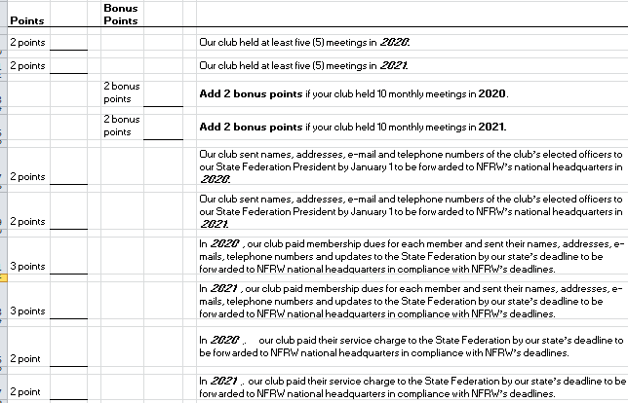
Road to Achievement Awards
Club Functions
You get 22 points for things that most clubs are already doing.

Slide 8
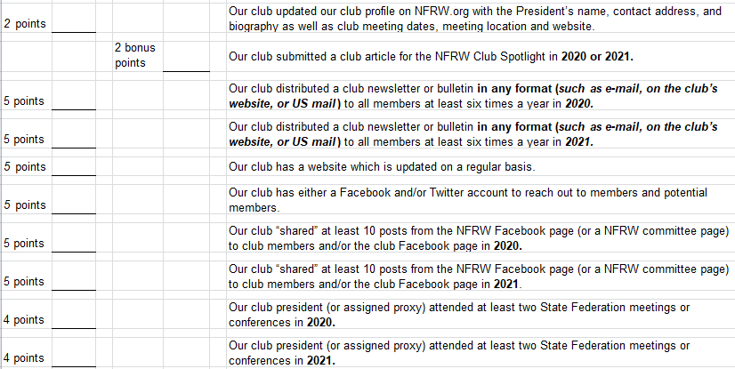
Road to Achievement Awards
Club Functions
You also get points for doing things you can easily do:

Slide 9
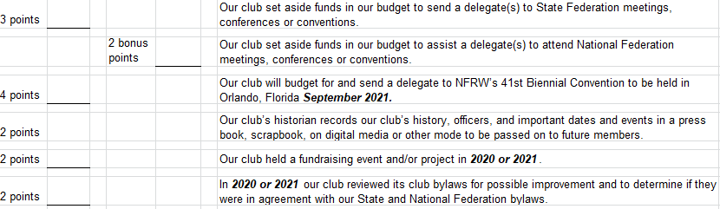
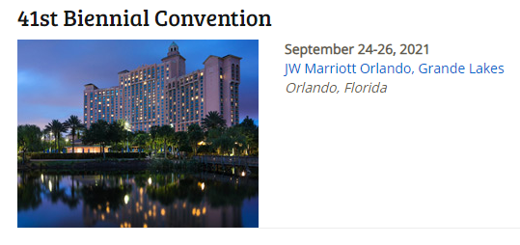
Road to Achievement Awards
Club Functions
You also get points for doing things you can easily do:

Slide 10
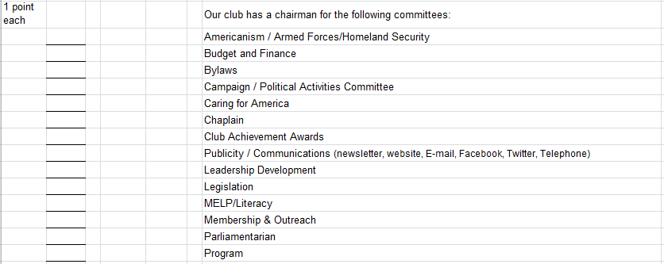
Road to Achievement Awards
Club Functions
Remember, the same person can be the chair of more than one committee!

Slide 11
Road to Achievement Awards
Club Functions
Some points you may have to work for:

Slide 12
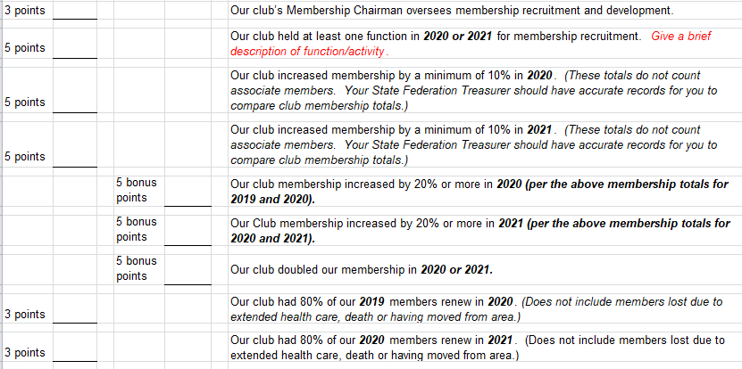
Road to Achievement Awards
Membership Development

Slide 13
Road to Achievement Awards
Membership Development
Sometimes we get lost in our own discussions a with the people we are comfortable with. When someone comes to your club for the first few times, as a visitor or a new member, make sure they are very welcome. No one should ever sit alone. This is the key to membership retention.

Slide 14
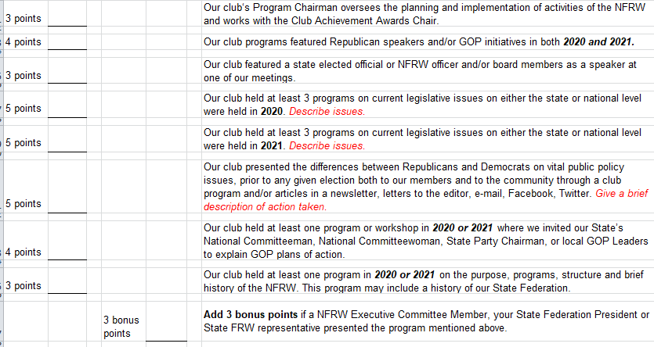
Road to Achievement Awards
Combine items for more points. Invite a Republican speakers to speak about issues!

Slide 15
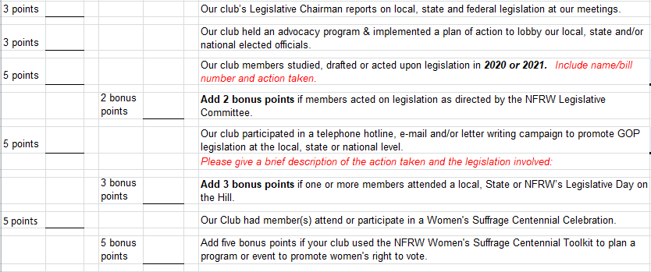
Road to Achievement Awards
There are many ways to mix and match to get the maximum points. That is why it is important for your club leadership to always ask, do we get Achievement Awards for this? If not, how can we tweak it so we can get the points. You can do all of these with a little creativity. Keep the ideas lab open at all times so you can be creative!

Slide 16
Road to Achievement Awards
You get points on the first two items if your president and treasurer attended the NvFRW training in either 2022 or 2023.
Notice on the last item, you just have to budget some funds for this.

Slide 17
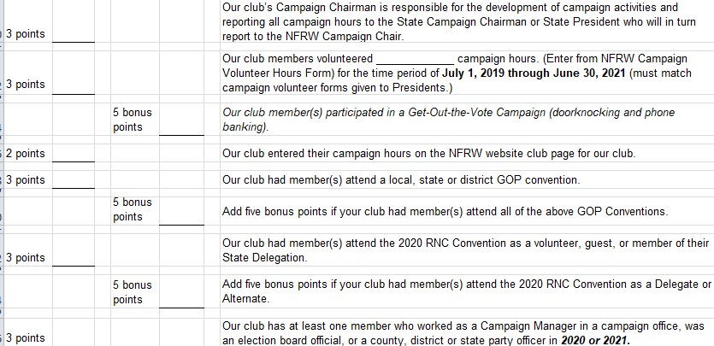
Road to Achievement Awards
2022 is the campaign year, so this is the year to maximize your campaign points. Be creative.

Slide 18
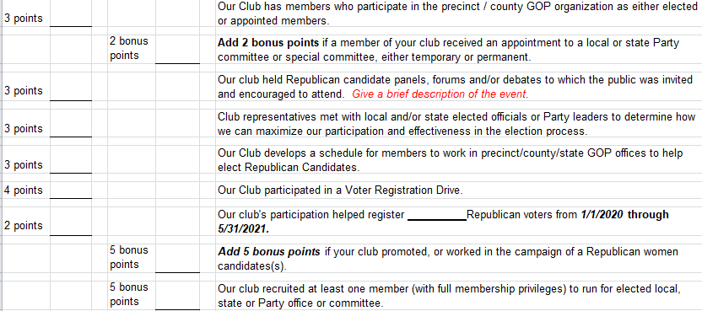
Road to Achievement Awards
Have voter registration forms with you at all events. If you have a booth, walk around and ask other booth participants if they need to register. Walk parades before they start to register voters.

Slide 19
Road to Achievement Awards
There are many ways to communicate: Press releases, email, social media, etc. The important thing is to use all of them in the most effective way possible.

Slide 20
Road to Achievement Awards
Most clubs already do this. However, if your club does not, it is very easy to start. You can pass a card around at your meeting and send it to a service member. Care packages are very inexpensive and very much appreciated.

Slide 21
Road to Achievement Awards
Again, this is easy to do. Ask your Caring for America chair to take care of this!

Slide 22
Road to Achievement Awards
We hope that this will not be an issue in the current biennium, but it could be. You can post items of interest about the Corona virus on your website or in your newsletter.

Slide 23
Road to Achievement Awards
Be sure to budget for this. This is one of the most rewarding areas and our children need to be educated, now more than ever and they must learn civics.

Slide 24
Road to Achievement Awards
Be sure to budget for this.
The outlay is minimal and there are 13 points here!

Slide 25
Road to Achievement Awards
If you have the budget for it, creating a scholarship program for a Republican Women in your area is very rewarding. Also, if your club contributes to NvFRW’s Jo Marshall Scholarship Fund, you qualify for these points.

Slide 26
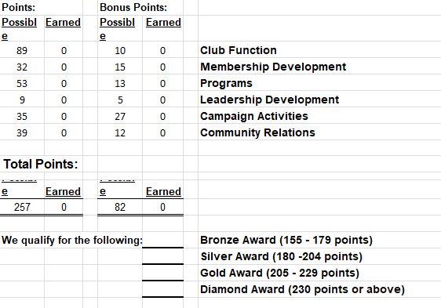
Road to Achievement Awards
This spreadsheet totals the points for you. Enter the points you earn as you earn them so you can see where you are. Then, work hard and be creative to add some more.
Toward the end of the biennium, you will see which award you will receive.

Slide 27
Road to Achievement Awards
In the past, I heard someone say that it didn’t matter whether you did it or not, just claim the points.
Don’t do it!
We are Republicans and one of our key platforms is personal responsibility. That includes honesty and integrity.
Think how proud you will be when you really earn that award!

Slide 28
Road to Achievement Awards
There are many ways to get there, so get creative and get started!

Slide 29
Road to Achievement Awards

